Slide 1
Highways and words: Does transience predict cultural diversity?
Anjali Bhatt & Molly Lewis
June 30th, 2017
Summer Institute in Computational Social Science

Slide 2
Motivation
Methods
Findings
Next Steps

Slide 3
Motivation
Methods
Findings
Next Steps

Slide 4
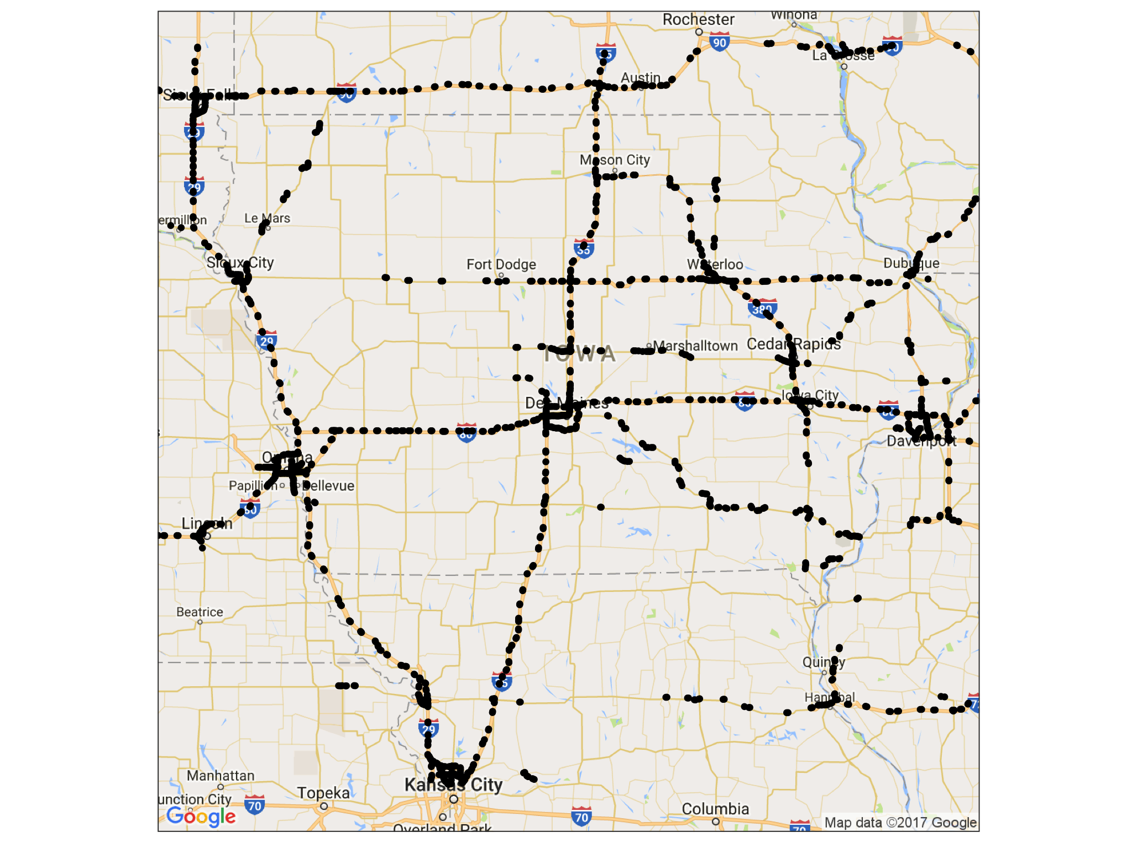

Slide 5
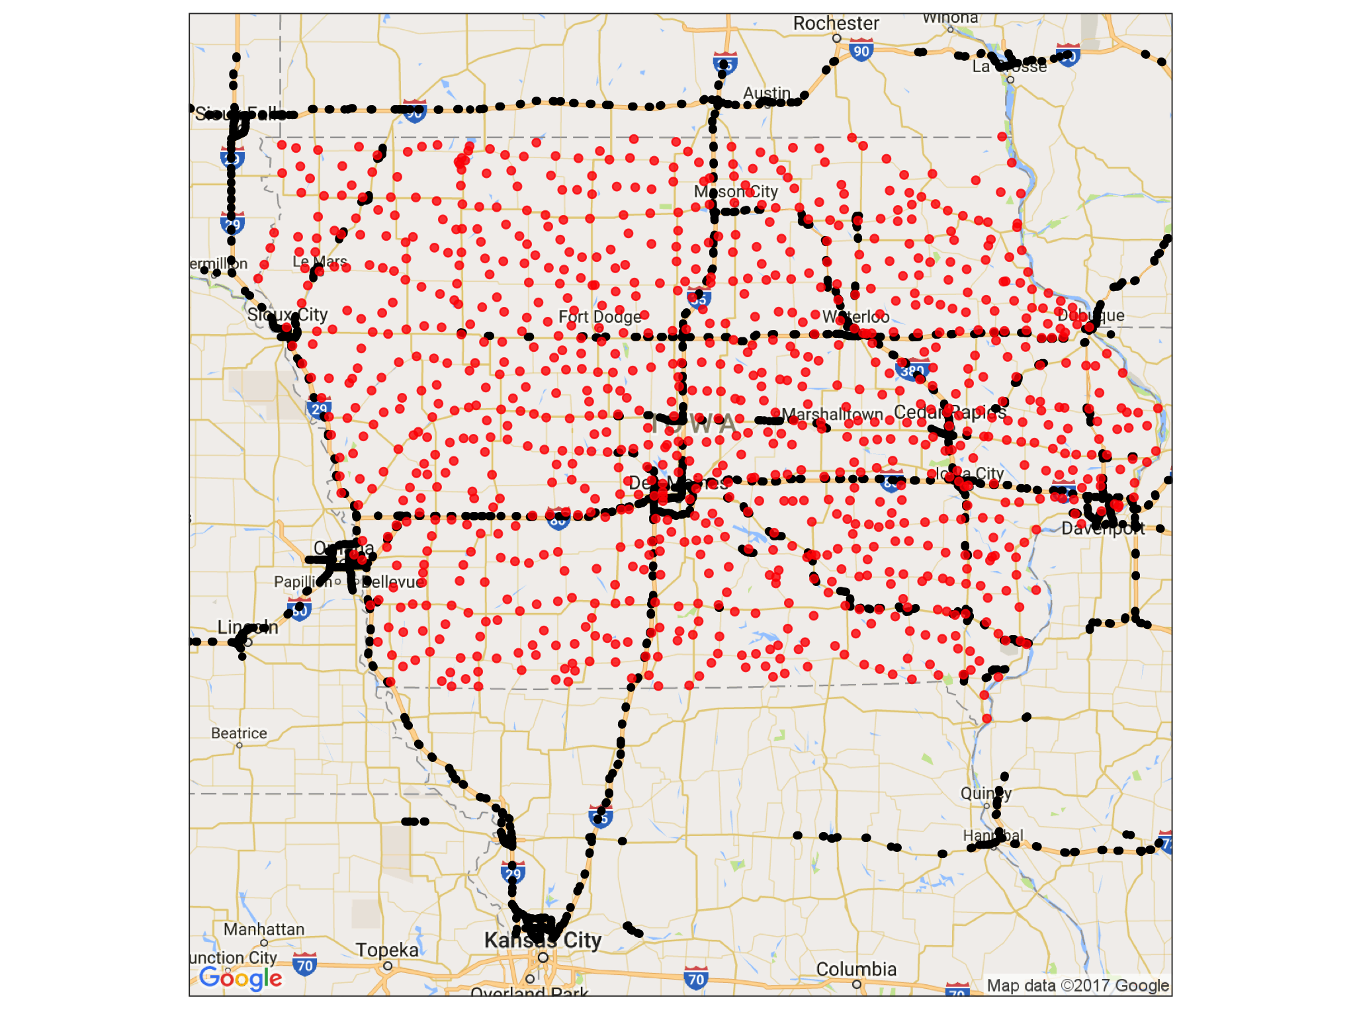

Slide 6
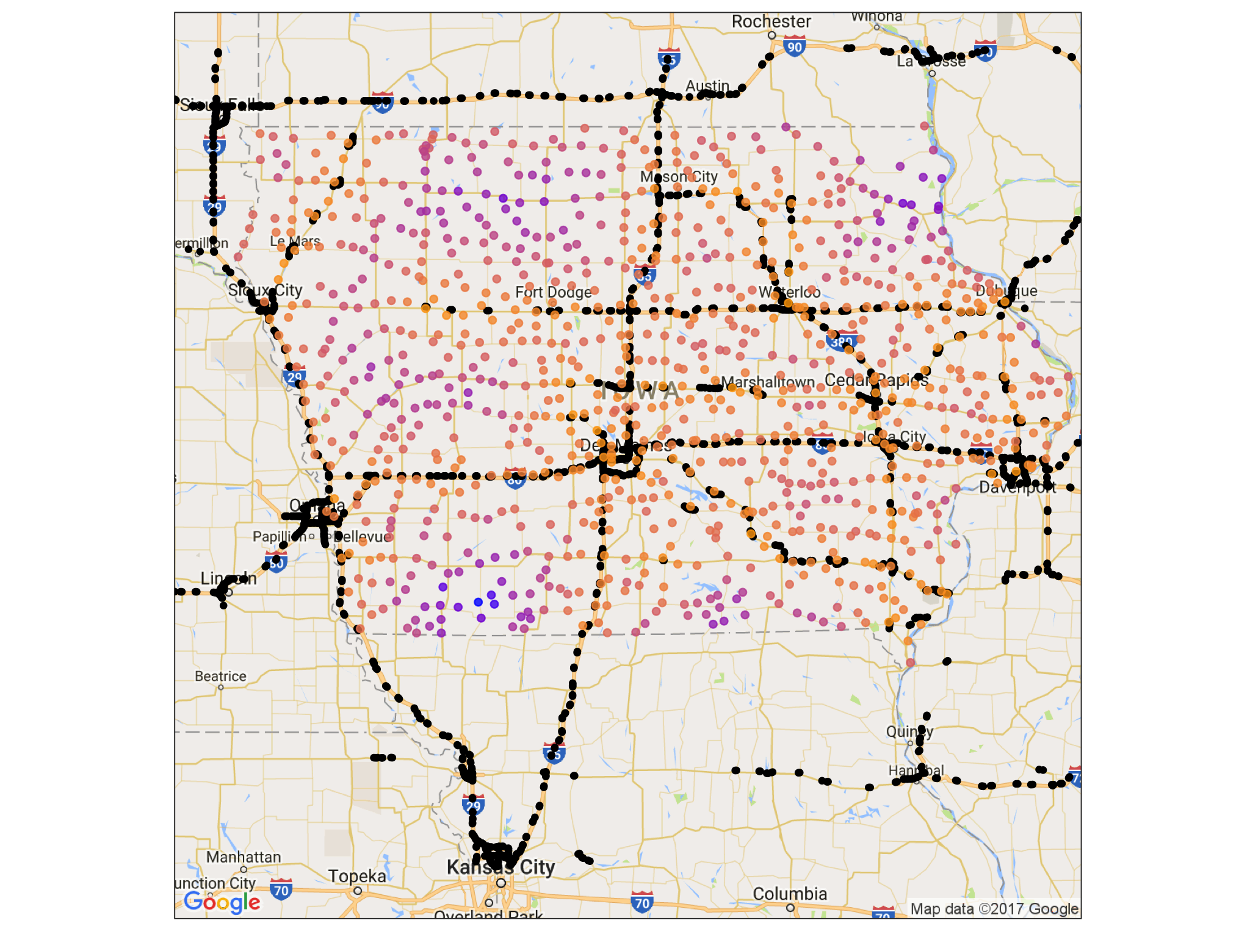

Slide 7
Motivation
Methods
Findings
Next Steps

Slide 8
Motivation
Methods
Findings
Next Steps

